Slide 1

Constant Bandwidth Server (CBS) in Real-Time Systems
Abu Sayem

Slide 2
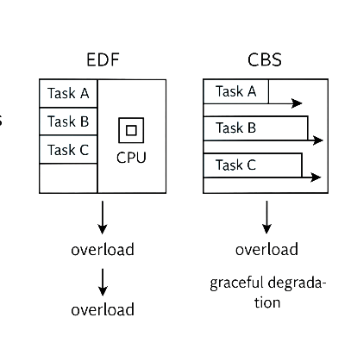
Motivation
Why we need CBS?
EDF, RMS perform poorly under overload.
Low-criticality tasks can breakdown
high-criticality tasks =No protection
CBS ensures tasks get only their share of CPU—nothing more

Slide 3
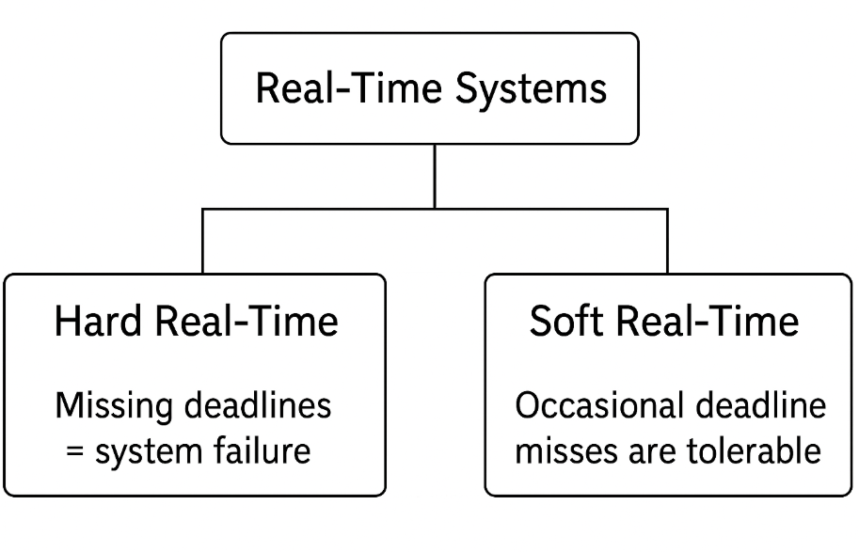
Introduction to Real-Time Systems
Correctness depends on Timing And Functionality
Used in avionics, automotive, robotics, medical devices.
.

Slide 4
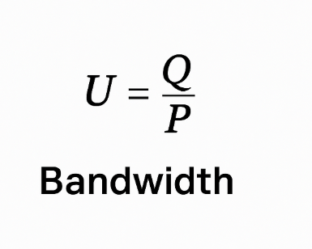
What is the Constant Bandwidth Server (CBS)?
Scheduling algorithm
Each task is assigned: budget (Q) , period (P)
Defines bandwidth .
Guarantees temporal isolation.
Helps maintain predictability even under overload.

Slide 5



Why CBS Works Well
Efficiency: CPU fairness, overload control .
Scalability : Multi-task handling, modular reservations, periodic & sporadic support.
Predictability : Temporal isolation, overload containment, subsystem composability.

Slide 6
CBS Efficiency
CPU fairness : Each task gets only its share.
Overload control : Prevents any task from overusing CPU.
Deadline management : Deadlines shift instead of crashing the system.
Efficient Utilization : System slows down, not fails, under load.

Slide 7
CBS Scalability & Predictability
Scalability:
Modular Bandwidth Allocation
Supports Many Tasks
Works with Mixed Workload
Composable Systems
Predictability :
Temporal Isolation
Bounded CPU Usage
Schedulability Guarantee
Overload Containment

Slide 8
CBS Algorithm
Budget (Q)
Period (P)
Bandwidth (U = Q / P)
EDF-Based Scheduling
Budget Exhaustion
Replenishment
Temporal Isolation

Slide 9
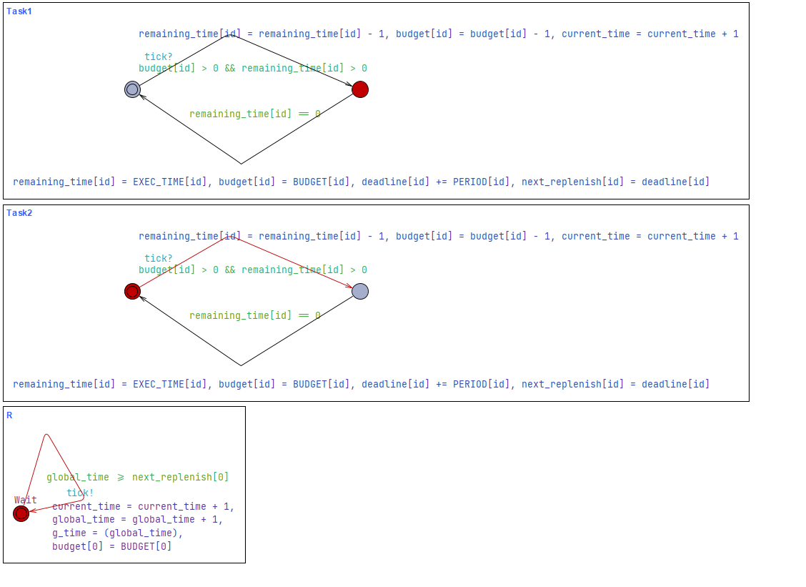
CBS Simulation in UPPAAL

Slide 10
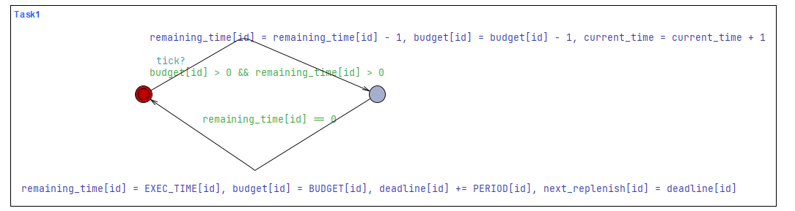
CBS Simulation in UPPAAL

Slide 11
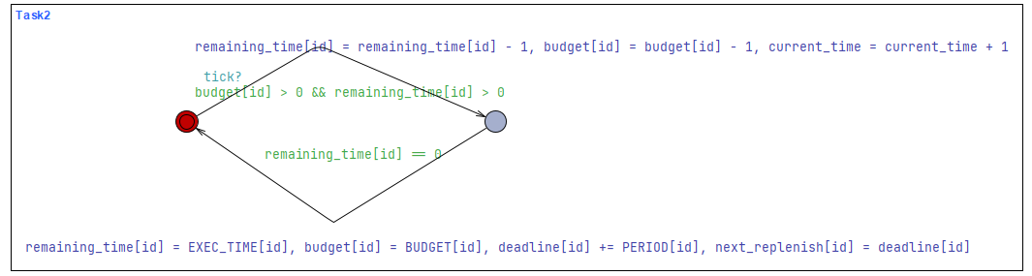
CBS Simulation in UPPAAL

Slide 12
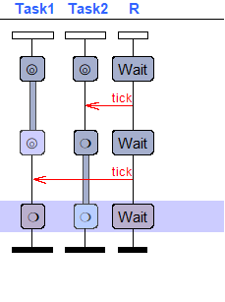
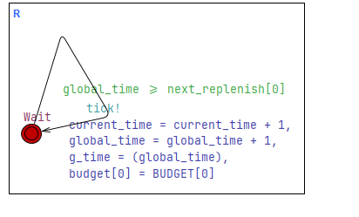
CBS Simulation in UPPAAL

Slide 13
Summary
The Constant Bandwidth Server (CBS) is a real-time scheduling technique that builds on EDF and RMS by adding bandwidth management with a defined budget and time per task. This makes sure that tasks don't interfere with each other and that execution is predictable, even when the system is overloaded. CBS provides smooth degradation, efficient CPU consumption, and modular scheduling for jobs that happen on a regular basis and those that happen only once in a while. In this presentation, we looked at CBS's algorithm, its main ideas (budget, period, bandwidth),its advantages (efficiency, scalability, predictability), and how it works in UPPAAL simulation. The model showed how CBS controls execution and makes sure that timing is right. CBS gives modern real-time and mixed-criticality systems a strong and flexible base.

